Slide 1


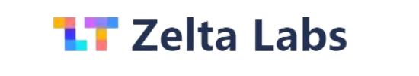
Kharagpur Data Science Hackathon 2024
Team - Data.py
Notes:
1. Table of contents
2. Introduction
3. Our company
4. Our team
5. Problem
6. Them vs. us
7. Solution
8. SWOT analysis
9. Product overview
10. Our plans
11. Product demo
12. Traction
13. Case study
14. Reviews
15. Awards
16. Market size
17. Target
18. Competitors
19. Business model
20. Timing
21. Predicted growth
22. Investment

Slide 2
Algorithmic Trading Model Development for BTC/USDT Crypto Market, aiming to outperform benchmark returns.
Problem Statement

Slide 3
Proposed Solution
Crafted BTC/USDT model using time-series LSTM.
Calculated max drawdown, sharpe ratio ,sortino ratio, and other required metrics.
Generated an interactive User-Interface.
Conducted meticulous backtesting for model reliability.
Prioritized robust risk management.
Real-time prediction implementation.
Sentiment analysis integration.
Model optimization for efficiency.

Slide 4
Overview
Data Acquisition
Data Preprocessing
Model Design
Historical price and trading data for BTC/USDT trading pair
Fit to timeframe ,adjust for splits,transformation
Time series model
LSTM
Backtesting
Risk Management
Sentiment analysis
Optimisation
backtesting using various historical data of the BTC/USDT market
Managing risks, maximizing potential profits.
Real-time sentiment analysis for BCT/USDT market
Fine-tune the
model

Slide 5
Data Acquisition
Data Source: Extracted from Yahoo Finance, providing a comprehensive dataset.
Trading Pair: Focused on the BTC/USDT trading pair, denoting Bitcoin to Tether.
Temporal Scope: Encompassing historical data from January 1, 2018, to January 31, 2022.
Original Columns: low,high,close,open ,volume of the BCT/USDT market

Slide 6
Why this dataset?
It is from Yahoo Finance which is known for its credibility in financial data provision.
Data is mostly clean and does not have missing values.
The data typically includes various features like Open, Close, High, Low, and Volume, allowing you to experiment with different input combinations for your LSTM model.
The data is naturally formatted as a time series, making it readily compatible with LSTM models.
Can download data for numerous stocks, commodities, and currencies, offering flexibility in choosing your target variable.

Slide 7
Data Preprocessing
Time frame Alignment: Ensured dataset compatibility specifically for Jan 1, 2018, to Jan 31, 2022.
Feature Enhancement: Added key columns ('Max Drawdown,' 'Portfolio Return,' 'Profit,' 'Gross Profit,' 'Average Trade Win,' 'Gross Loss,' 'Average Trade Loss') for richer insights.
Scaling: The features are standardized using MinMaxScaler to bring them to a common scale.
Reshaping: The data is reshaped into the format required by the LSTM model (3 dimensions: samples, timesteps, features).

Slide 8
Model Design
Long Short-Term Memory (LSTM) is a type of recurrent neural network (RNN) architecture designed for capturing and learning patterns in sequential data, making it particularly effective for time series analysis and prediction.
The code builds a sequential LSTM model with one LSTM layer with 25 units and a ReLU activation function. The input shape is defined based on the reshaped data.
A Dense output layer with one neuron is added as the model predicts a single value (closing price).
The model is configured with the Adam optimizer and mean squared error loss function for training.
The model is then trained for 50 epochs with a batch size of 32. Verbose mode 2 provides training progress updates.

Slide 9
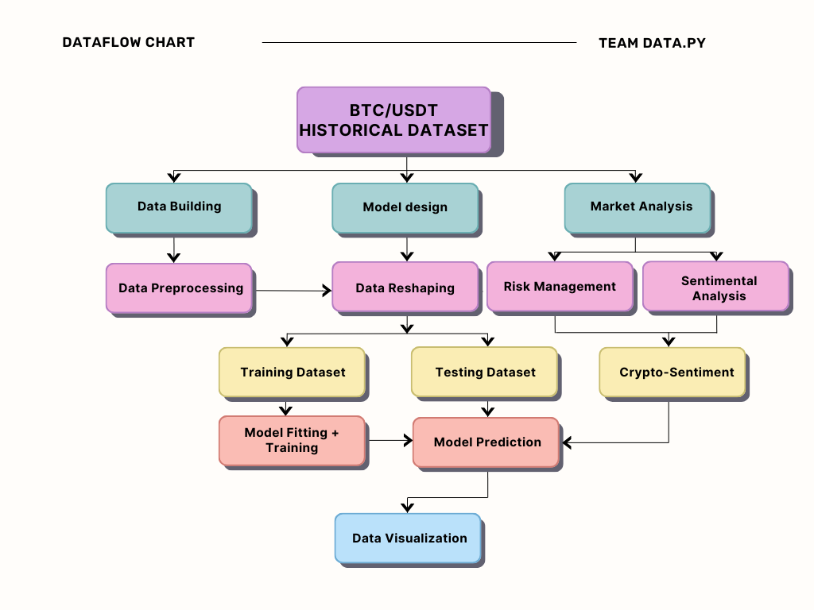
Model Design Architecture

Slide 10

Model Output

Slide 11
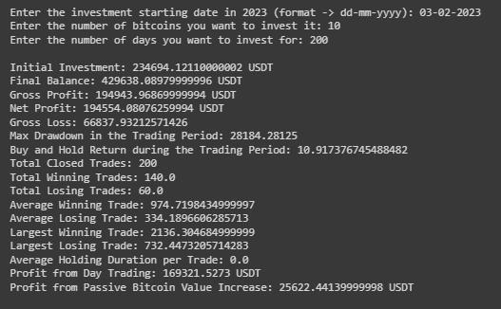
Model Output

Slide 12
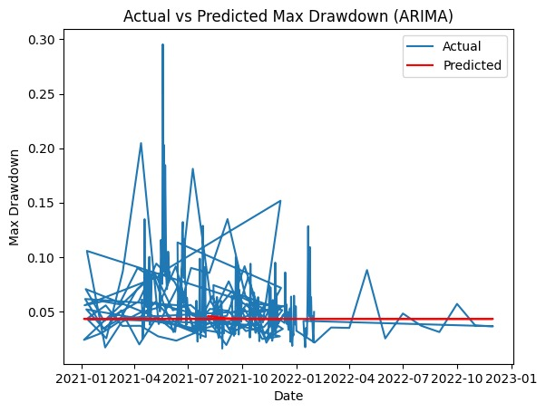
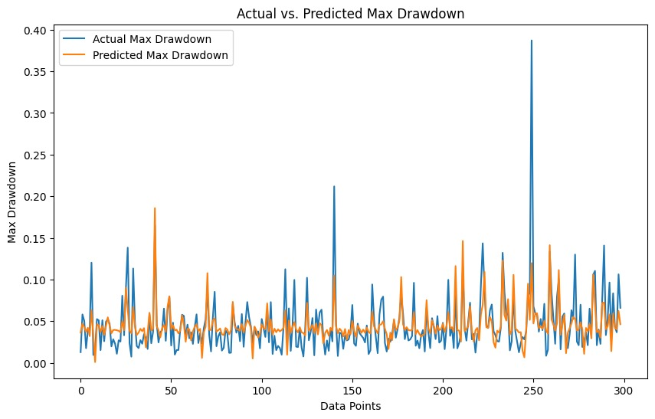
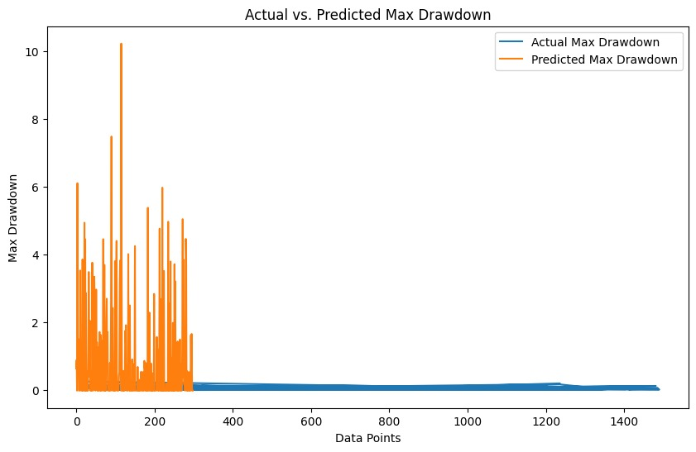
OTHER MODELS
ARIMA
LINEAR REGRESSION
1D-CNN

Slide 13
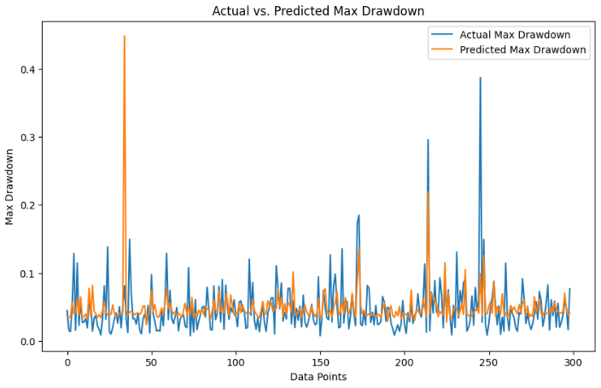
LSTM MODEL

Slide 14
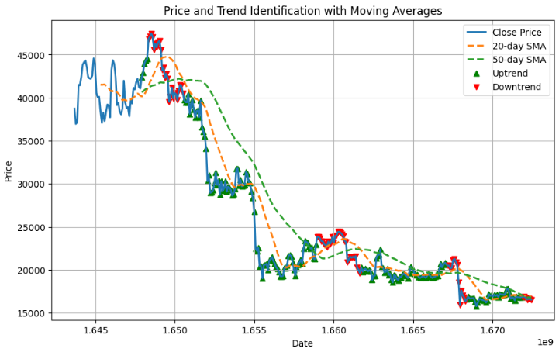
TREND VISUALISATION

Slide 15
Backtesting
Making multiple test models: Creating extra models using the same framework to test the datasets on.
Optimization Understanding: Having multiple models gives a better understanding of how different hyperparameters affects the working of the learning of the model, hence allowing optimization to be more easily found and understood.
We trained our models on different datasets of different sizes and tested them on the same existing data for a fair comparison.

Slide 16
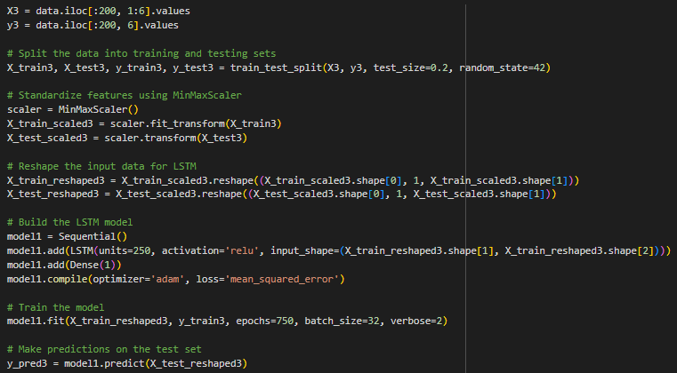
Backtesting working

Slide 17
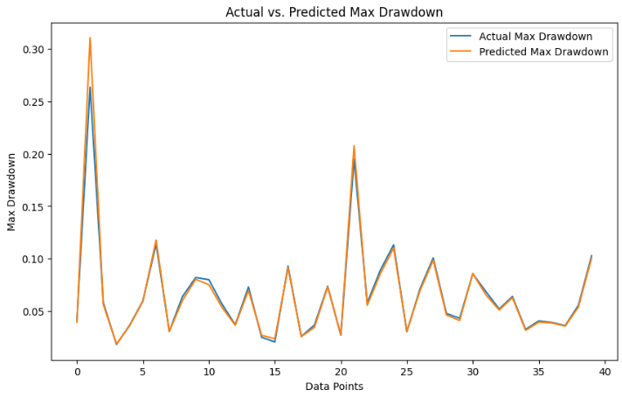
Backtesting Results

Slide 18
Risk Management
Our risk management strategy involves setting a maximum drawdown threshold, allowing us to categorize whether to 'HOLD' or 'BUY/SELL' based on predicted drawdown values. To assess potential profits, we simulated a trading scenario where we sell a portion of the cryptocurrency on 'BUY/SELL' decisions.
The final profit is calculated by considering both active day trading and passive profit from the increase in Bitcoin value. Our output provides a detailed breakdown, encompassing the initial investment, final balance, total profit, and profits attributed to both day trading and passive value increase.

Slide 19
Risk Management Rules
Risk Threshold: Setting a base-level drawdown which is acceptable for a trade.
Risk-Considered Decisions: Suggested decisions based on the given threshold.
Sharpe Ratio: Calculated based on the estimated revenue and
Sortino Ratio: Accounted for 0.15% transaction costs and slippage in simulations.
Sample Run: A simulated run of a person using our model is shown for each test

Slide 20
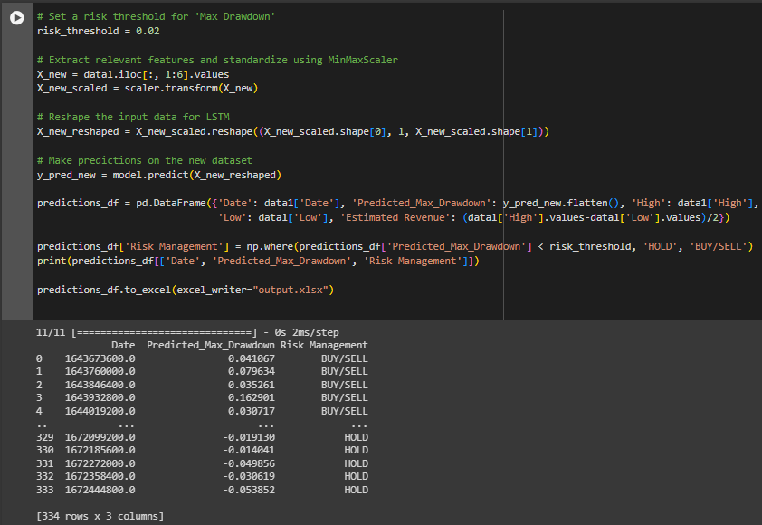
Risk Management working and output

Slide 21
Sentiment Analysis
Real-time scraped news analysis with Vader sentiment reveals the market's emotional pulse.
Sentiment-driven classification categorizes news, from bullish cheers to bearish concerns.
Interactive visualizations dissect trends, unveiling the story behind the sentiment.
A simple yet effective recommendation system for our model successfully implemented.

Slide 22
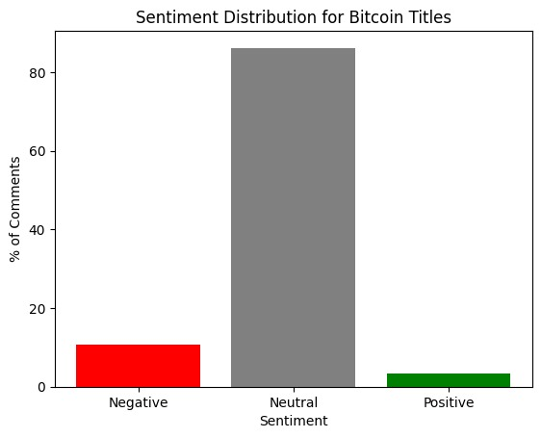
Real-Time Sentiment Analysis
Leveraging real-time Google News sentiment analysis, gain granular insights into evolving Bitcoin market sentiment, empowering informed investment decisions.

Slide 23
Model usage in real world
Empowering Fintech enthusiasts with LSTM insights.
Offering LSTM-driven solution for confident crypto exploration.
Providing essential LSTM knowledge for thriving in the digital realm.
Supporting entry into digital assets with LSTM-backed strategies.
Enabling career pursuits in crypto with LSTM-based education.
Enhancing decision-making with our LSTM-driven model.
Guiding business leaders toward success with LSTM expertise.

Slide 24
Future Scope
Improved architecture: Experimenting with different LSTM layers, units, activation functions, and hyperparameters can enhance the model's accuracy and adaptability.
Ensemble models: Combining our LSTM with other models or Support Vector Machines can potentially provide more robust predictions.
Technical indicators: Adding technical indicators as features could strengthen the model's understanding of market signals and patterns.
Real-time updates: Retraining the model with updated data periodically can improve its performance and adaptability to changing market conditions.

Slide 25
Our Team
Krish Aryan
Harshitha Ravani
Ankit Bhattacharjee
Cho Laqshya

Slide 26
Thank You

